Slide 1

POORNIMA COLLEGE OF ENGINEERING DEPARTMENT OF INFORMATION TECHNOLOGY
An
INDUSTRIAL TRAINING SEMINAR PRESENTATION
on
“FRONT-END WEB DEVELOPMENT”
Session: 2024-25
Presented to:
Ms. Priya Shekhawat
Mr. Alok Singh
Designation: Faculty Coordinators
Presented By:
Name: MAYANK BHANWARA
Reg. No.: PCE23IT029
Branch: Information Technology

Slide 2
Content
Introduction to Company
Prerequisites of the Training
Training Description
IDE Used
Day Wise Schedule
Technology Used
Project Description
Snapshots of Project
Conclusion and Future Scope
References

Slide 3
Introduction to Company
Company Name: Bussibees Ed-tech Pvt. Ltd.
About: Bussibees Ed-tech Pvt. Ltd. is a pioneering education technology company dedicated to transforming the learning landscape through cutting-edge digital solutions. The company delivers innovative tools and platforms designed to empower educational institutions and businesses with scalable and impactful digital learning solutions.
HR Name: Mr. Neeraj Sharma
Mobile Number: 8619003586
E-mail: info@bussibees.com
Website: www.bussibees.com

Slide 4
Prerequisites of the Training
Basic Computer Knowledge
Internet Navigation Skills
Fundamental Typing Skills
Basic Understanding of Web Browsers

Slide 5
Training Description
Time Period: 15 Days
Starting Date: 11 July 2024
Ending Date: 26 July 2024
Working Hours: 5 hours/day
Location: Jaipur, Rajasthan
Address of the Company: Baba Vidhan Sabha Nagar Patrakar rd near Orient Residency, Jaipur, Rajasthan - 302020
Training Coordinator: Mr. Shiryansh Sharma
Designation: Trainer
Training Coordinator Email: shiryansh7012@gmail.com

Slide 6
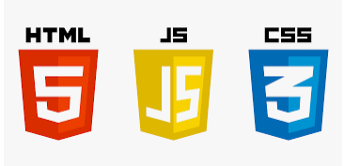


IDE Used
Technology Used
HTML
CSS
JavaScript
VS Code
Notepad

Slide 7
Day Wise Schedule
WEEK 1
Introduction to HTML
Basic HTML Tags
Formatting Text and Links
Images and Media
Table and Forms

Slide 8
WEEK 2
Introduction to CSS
Selectors and Properties
Box Model and Layout
Styling Text and Fonts
Responsive Design

Slide 9
HTML
HTML (HyperText Markup Language) is the standard language for creating web pages. It structures the content on a webpage using elements like headings, paragraphs, links, and images. HTML forms the backbone of any website, making it essential for web development.
Key Details About HTML =>
Structure of Webpages: HTML provides the foundational structure of a webpage, including
text, images, and links, arranged using various tags and elements.
2. Elements and Tags: HTML uses a system of tags (like <p>, <a>, <div>) to define different
types of content and how they should be displayed in the browser.
3. Cross-Platform Compatibility: HTML is supported by all major web browsers, making it a
universal language for creating and displaying web content across different devices platforms.

Slide 10
CSS
CSS (Cascading Style Sheets) is the language used to style and design web pages. It controls the layout, colors, fonts, and overall visual presentation of the content structured by HTML. CSS enhances the user experience by allowing developers to create visually appealing and responsive designs.
Key Details About CSS =>
1. Styling and Layout: CSS allows developers to control the appearance of HTML elements, including
colors, fonts, spacing, and positioning, making webpages visually attractive.
2. Cascading Rules: CSS follows a cascading order where styles are applied based on specificity,
inheritance, and importance, enabling flexibility in design customization.
3. Responsive Design: CSS enables web pages to be responsive, meaning the layout adjusts to
different screen sizes and devices, enhancing accessibility and usability.

Slide 11
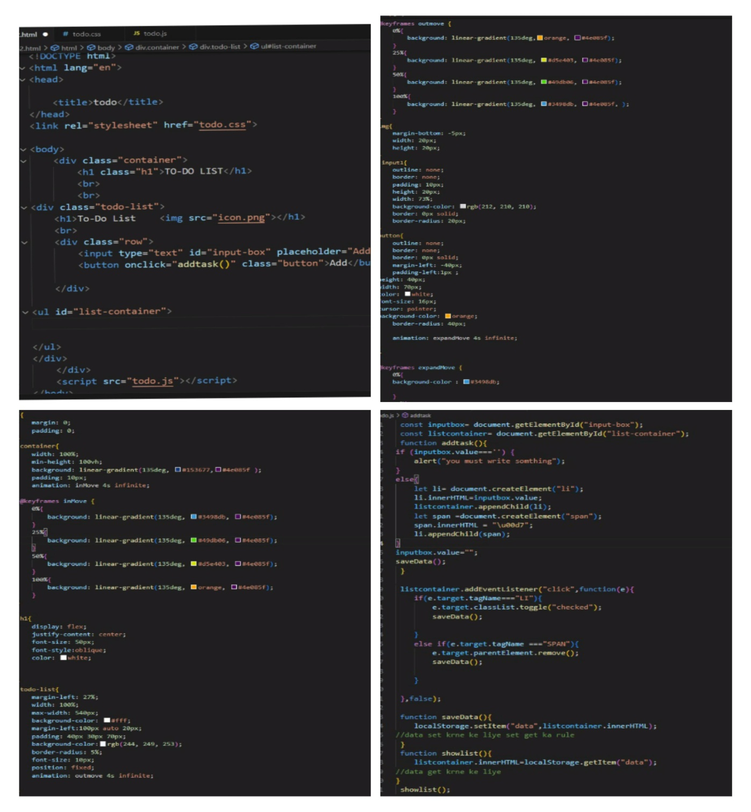
Project Description
Project Name: todo-list
Project Coordinator: Shiryansh Sharma

Slide 12
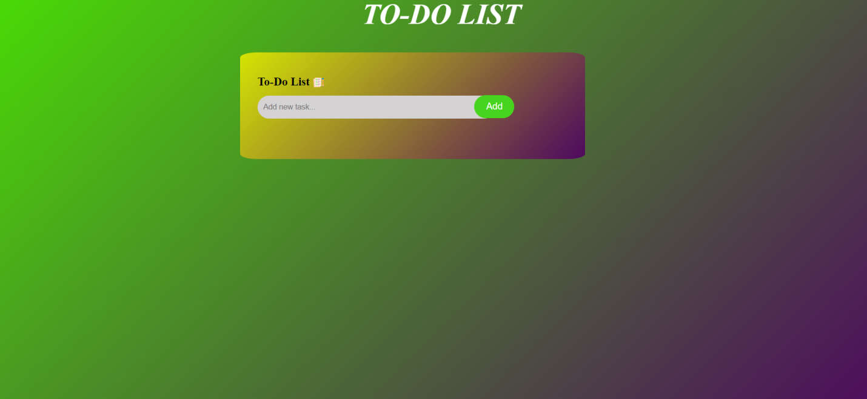
Snapshots of Project

Slide 13

WRITE THE TASK

Slide 14
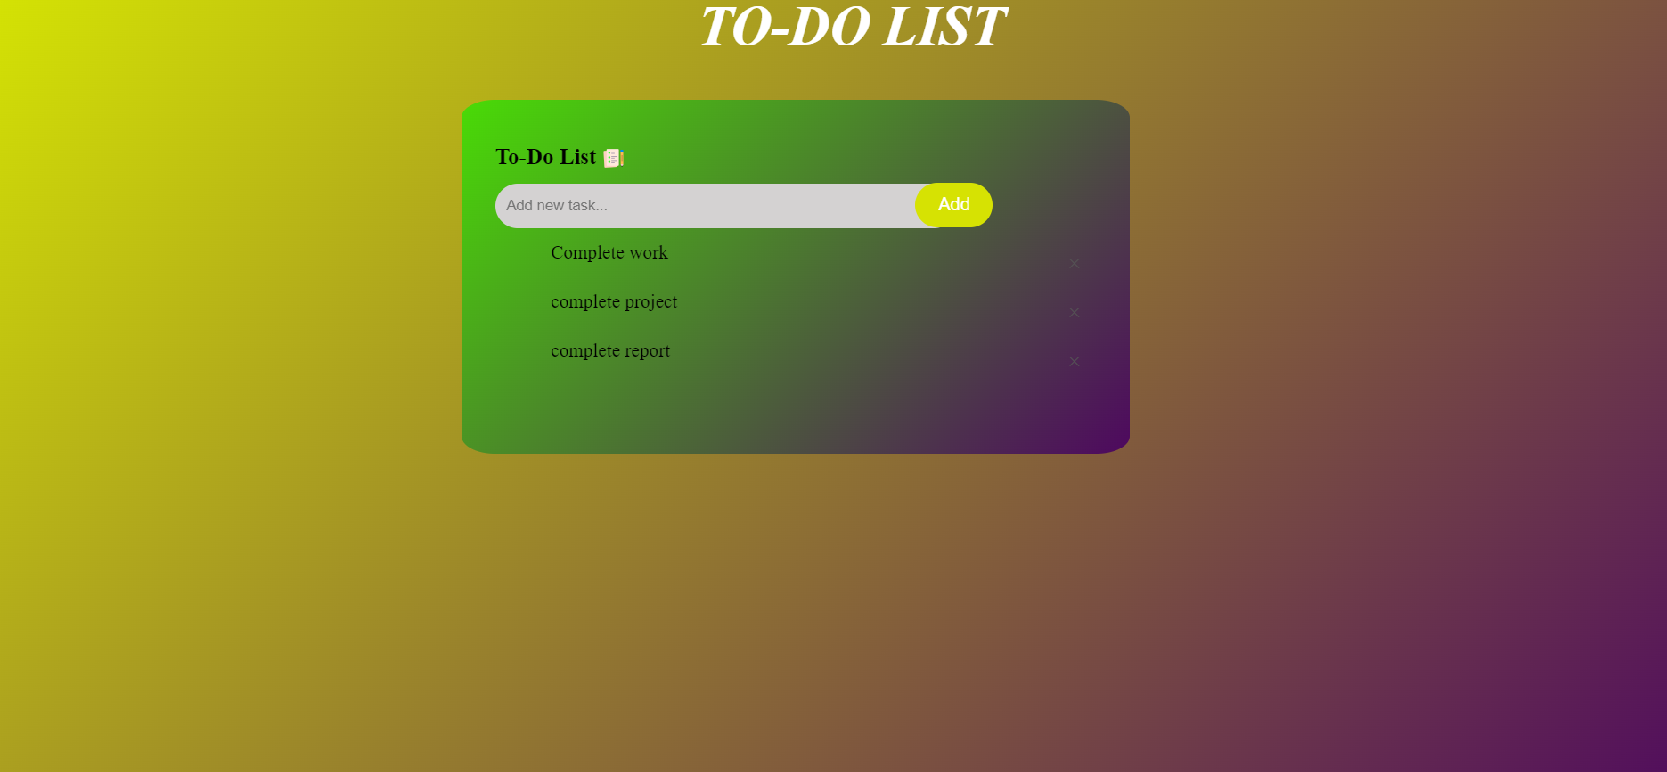
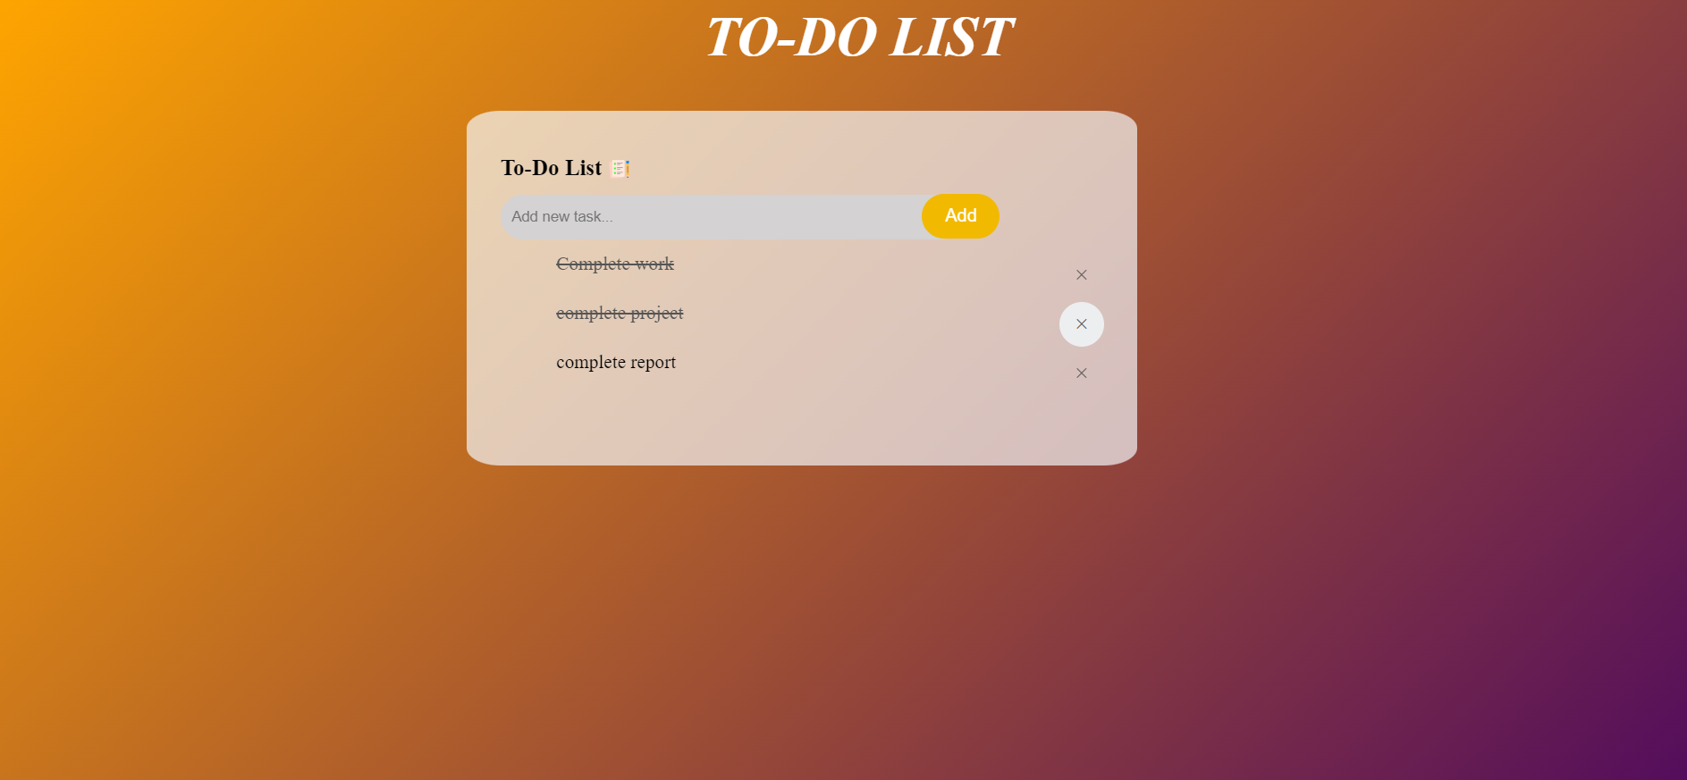
AFTER COMPLETING TASK
DELETE AND REMOVE THE TASK

Slide 15

You are not writing something and click on add ,then this show alert there

Slide 16
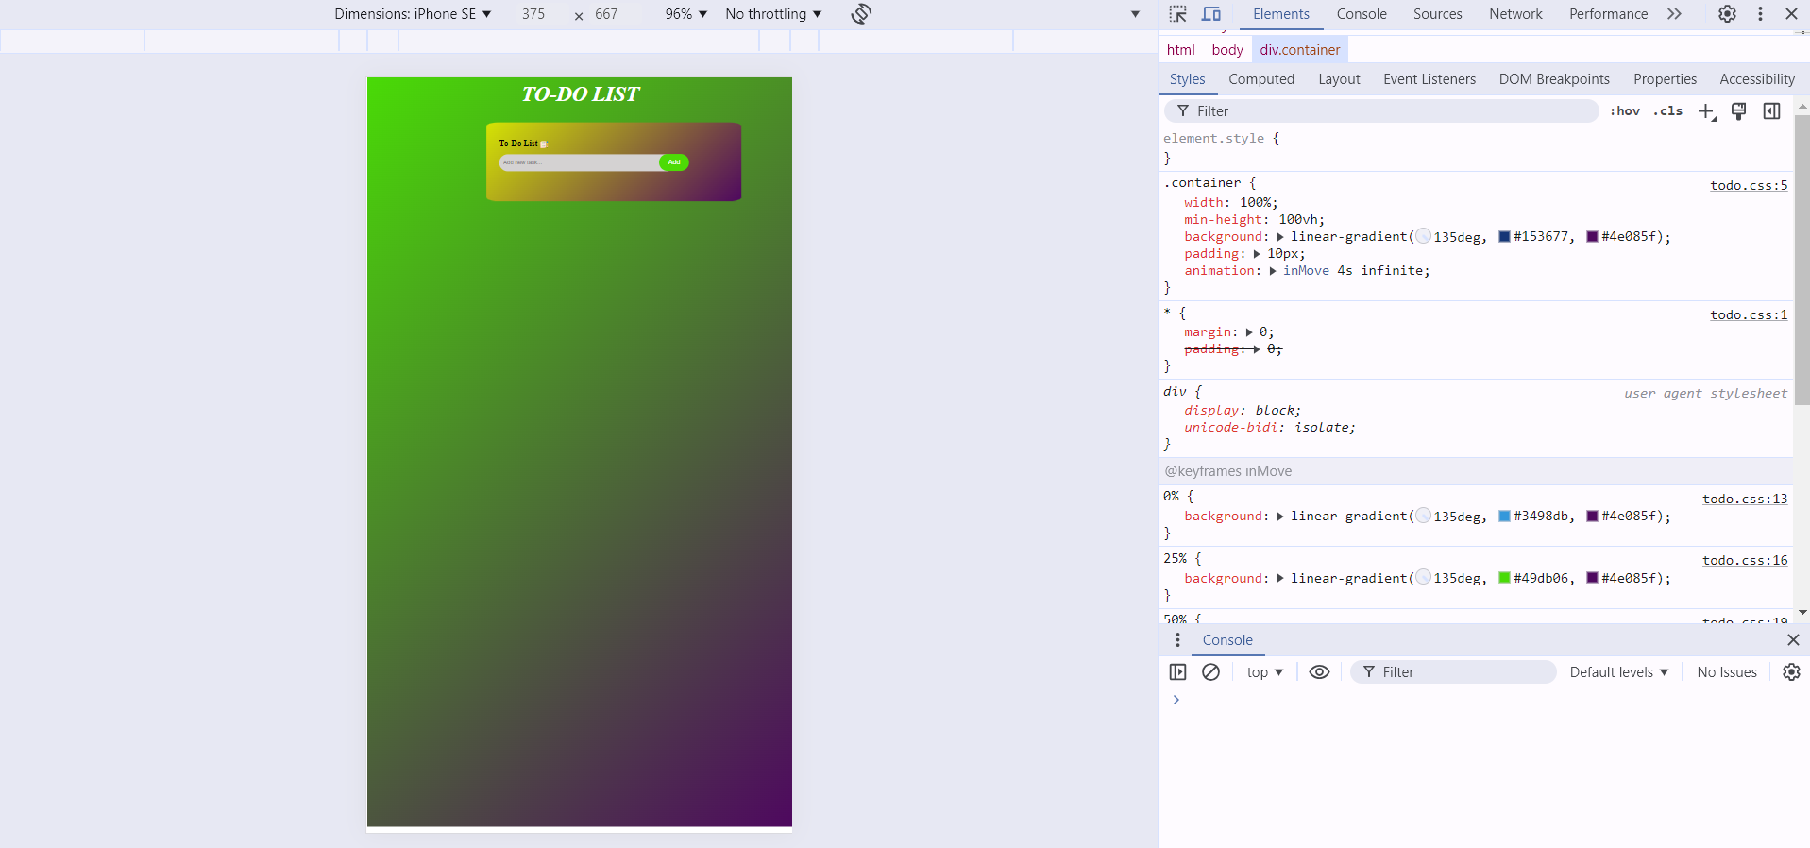
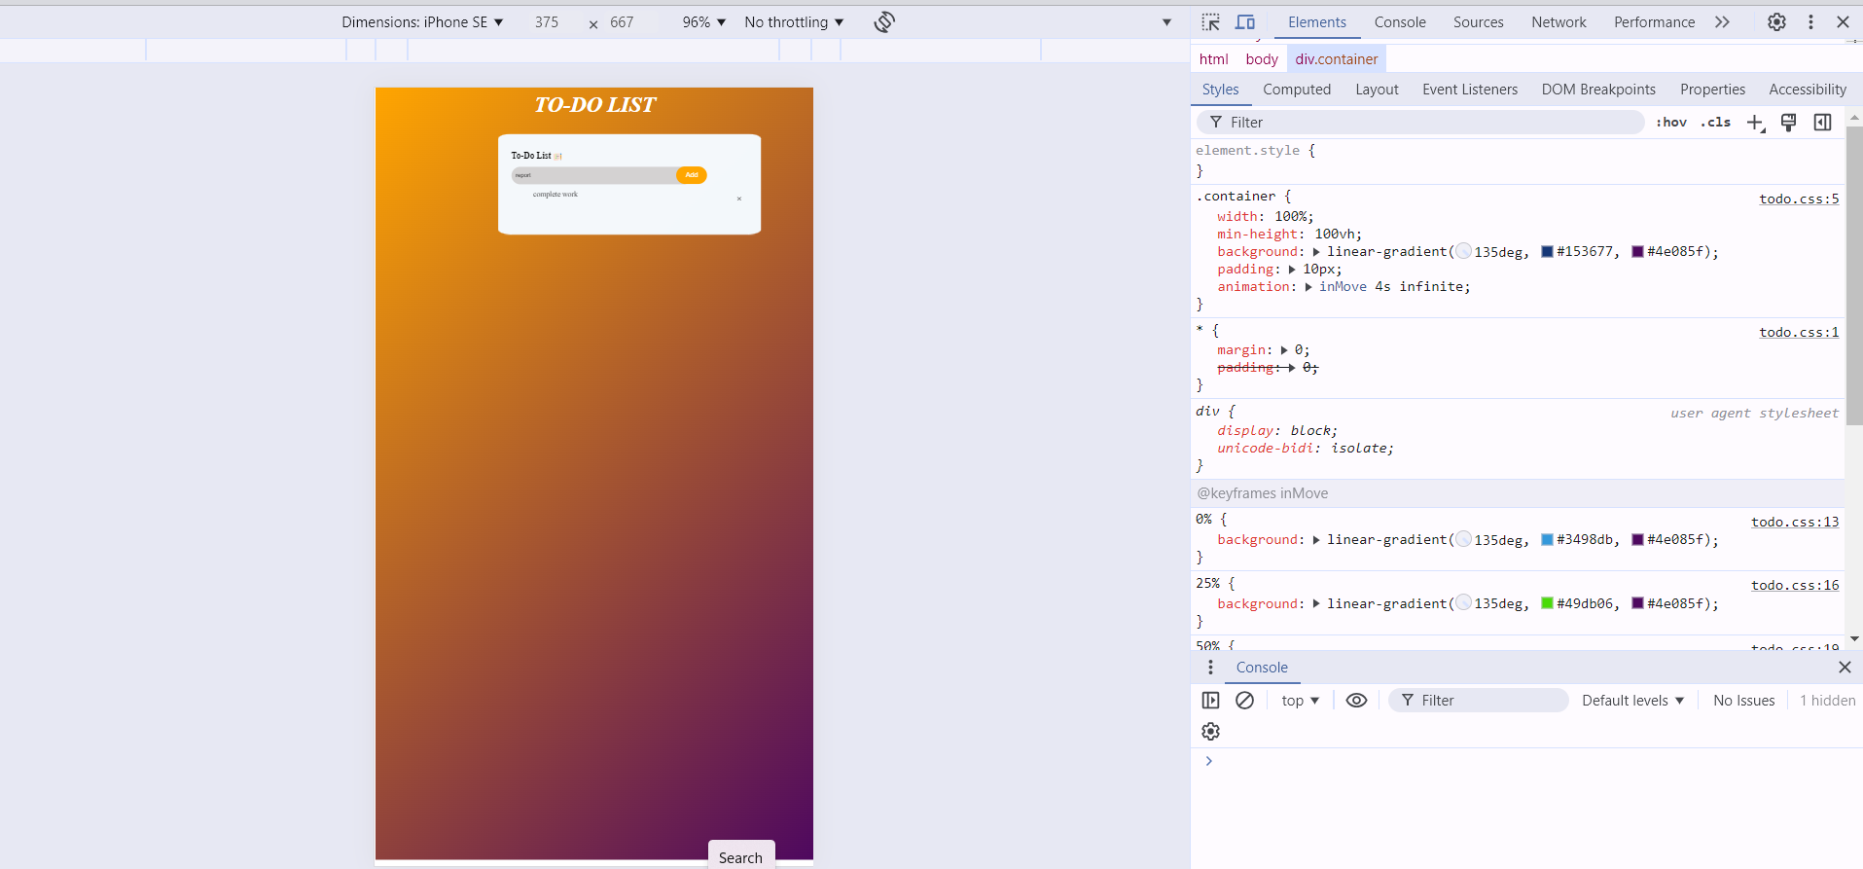
RESPONSIVE PAGE

Slide 17
Conclusion
Project Summary: The todo list website successfully showcases the power of web development by combining HTML for structure, CSS for design, and JavaScript for functionality. It provides a robust platform for enhancing the todo list digital presence.
Objectives met: develop a comprehensive and user-friendly to-do list that meets the needs of the targets audience.implemented features such as task prioritization, deadlines and reminders, enhancing user productivity and organization.
Future Recommendations:
Explore additional features such as integration with other productivity tools or advanced analytics for task management. the project has demonstrated the effectiveness of a well-structured to-do list in improving personal and professional organization.

Slide 18
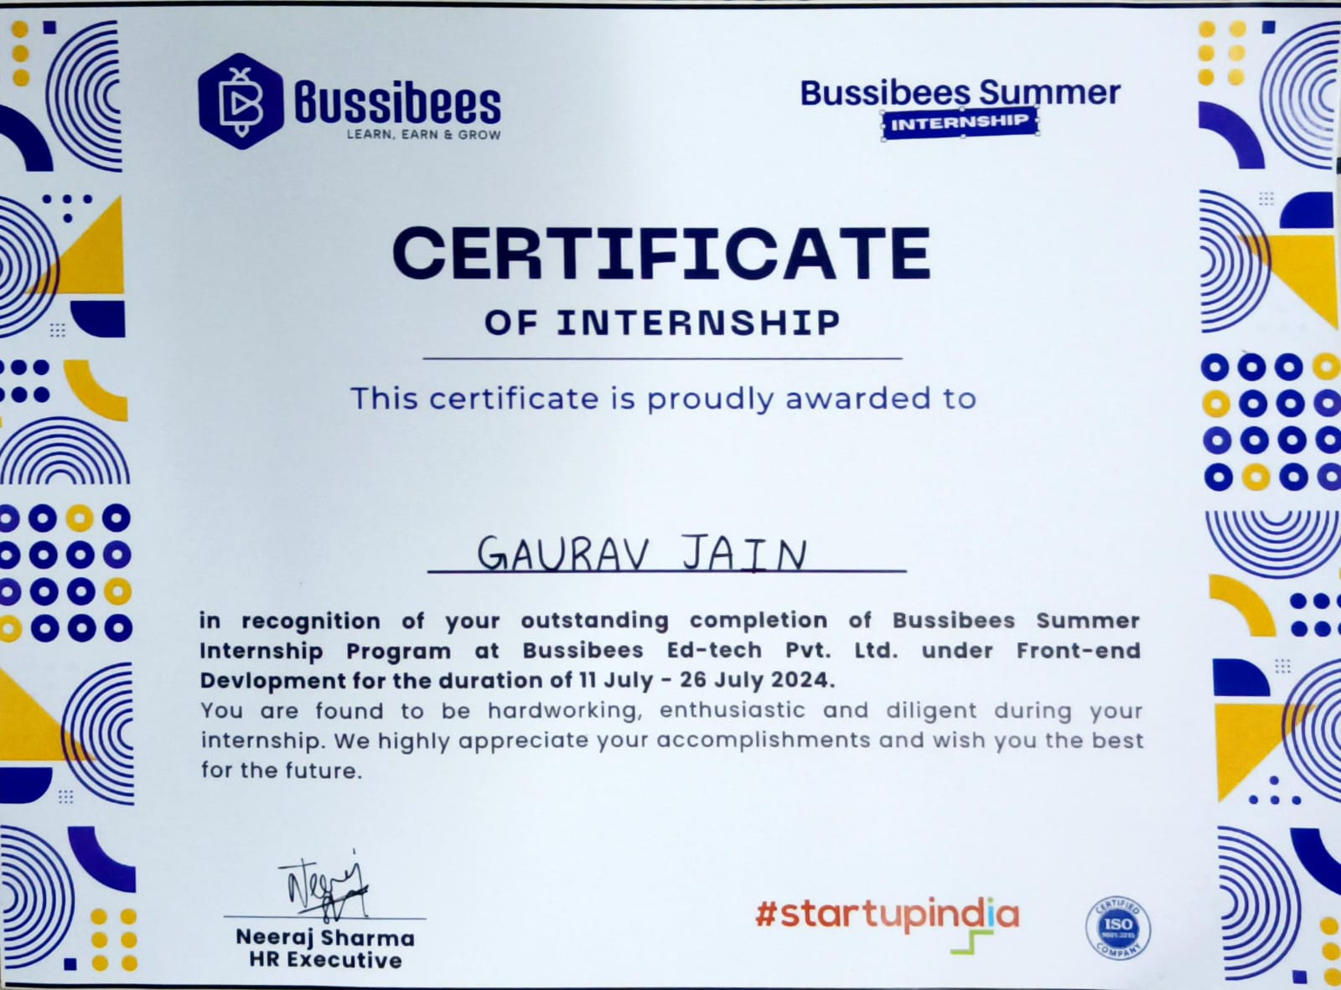
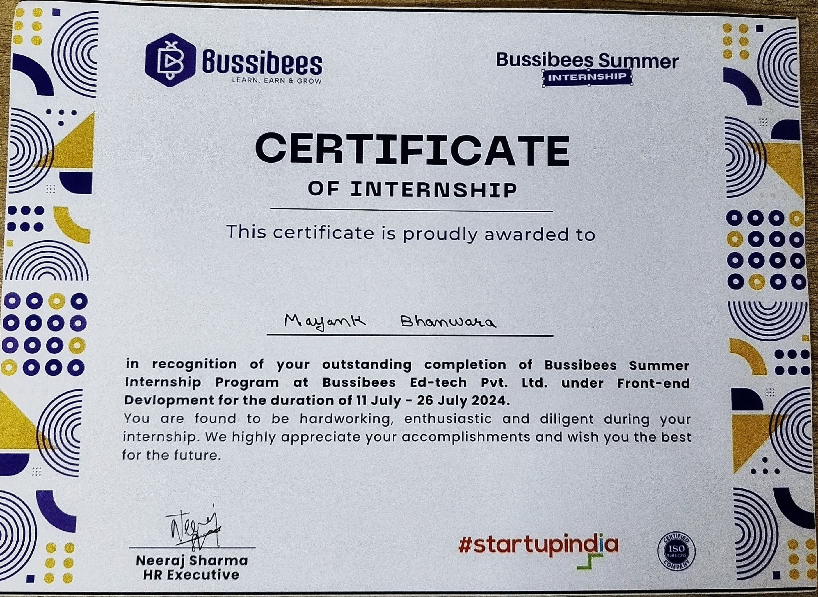

Slide 19
THANKYOU

